Slide 1
High performance computing simulations
for multi-particle effects in the synchrotons

Slide 2
Content
What is the HSC section doing?
Physics basics
PyHEADTAIL software
Simulations of the PS
Simulations of instabilities in the LHC

Slide 3
What is the HSC section doing?
HSC = Hadron Synchrotron Coherent effects
Simulate the way the particles move and how they interact with each other (multi-particle beam dynamics)
Analyze instabilities to improve the machines
Simulate new accelerators (e.g. FCC) or upgrades (e.g. HL-LHC) to analyze whether the plans work
Necessary to set parameters:
Number of particles per bunch (intensity)
Beam size (emittance)

Slide 4
Physics basics
Closed orbit, different dimensions, Quadrupoles and Gaussian distribution

Slide 5
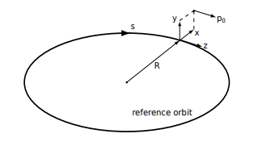
Closed Orbit
= “perfect” path for the beam particles
Particles on the closed orbit pass through the same points every turn around the circular accelerator
Almost none of the particles are injected on the closed orbit so they are forced to oscillate around it (like harmonic oscillator)
Transverse: by the quadrupole magnets
Longitudinal: by radio frequency cavities

Slide 6
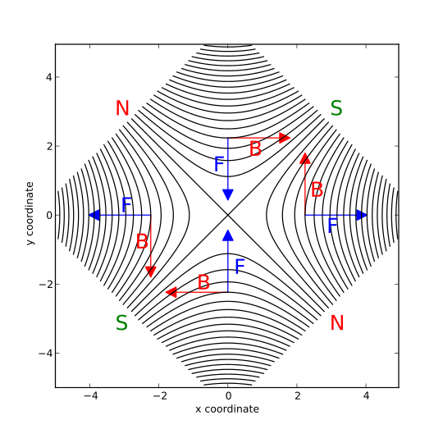
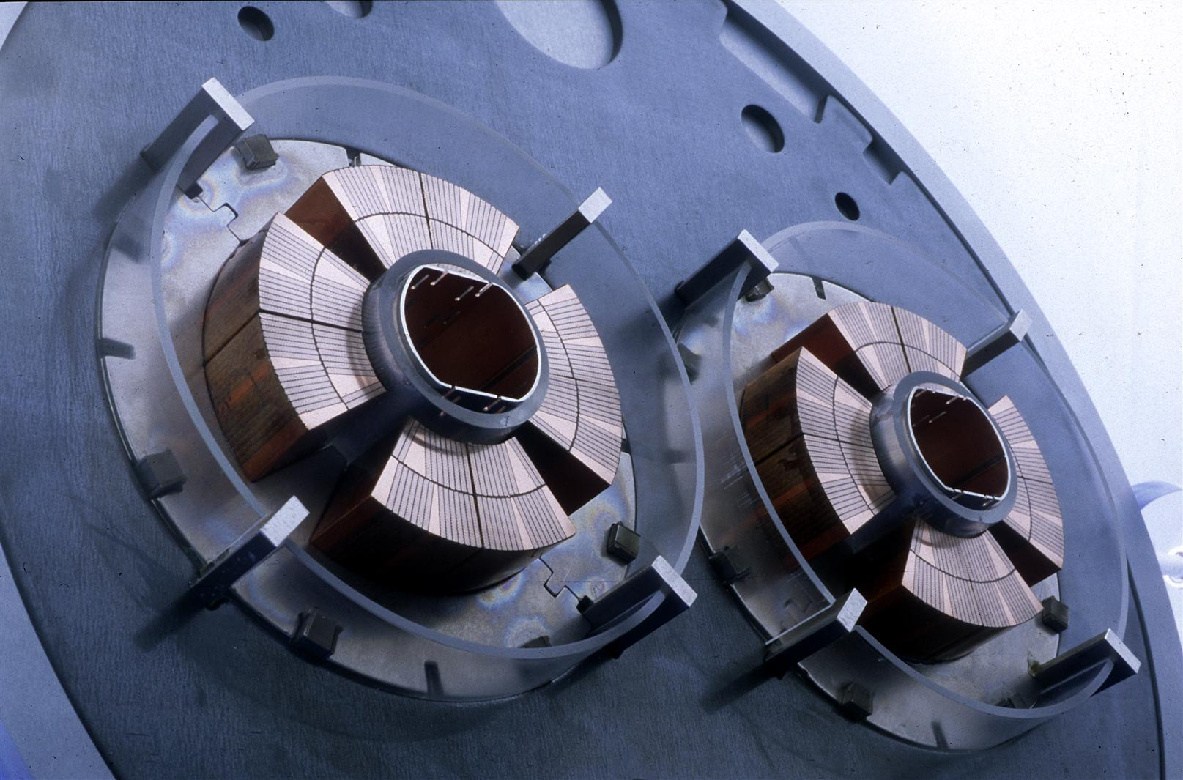
Quadrupole Magnets
Quadrupoles focus in the one direction (e.g. vertically), but defocus in the other one (e.g. horizontally)
Next quadrupole magnet is rotated 90° so that the particles oscillate

Slide 7
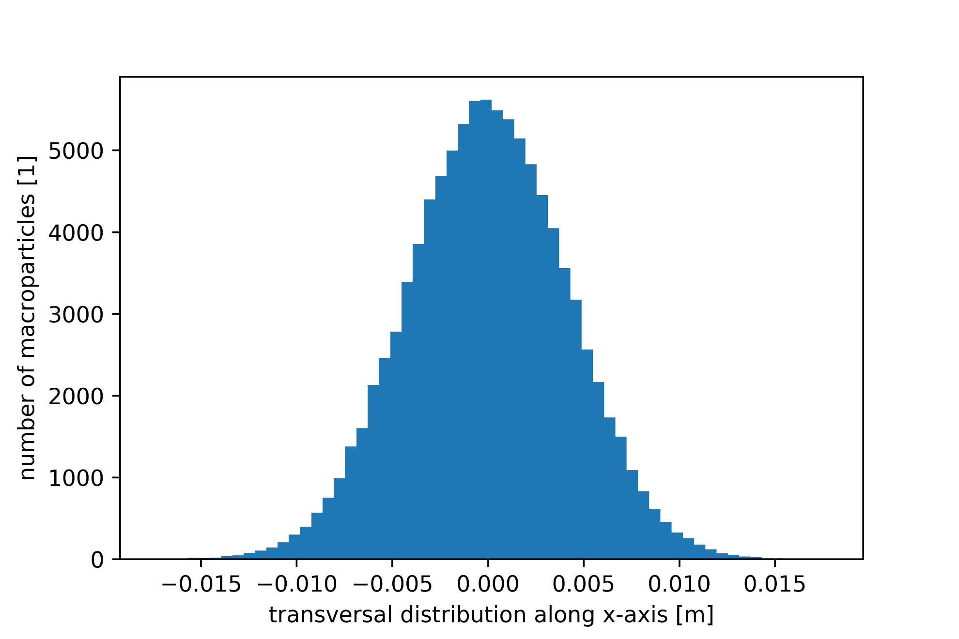
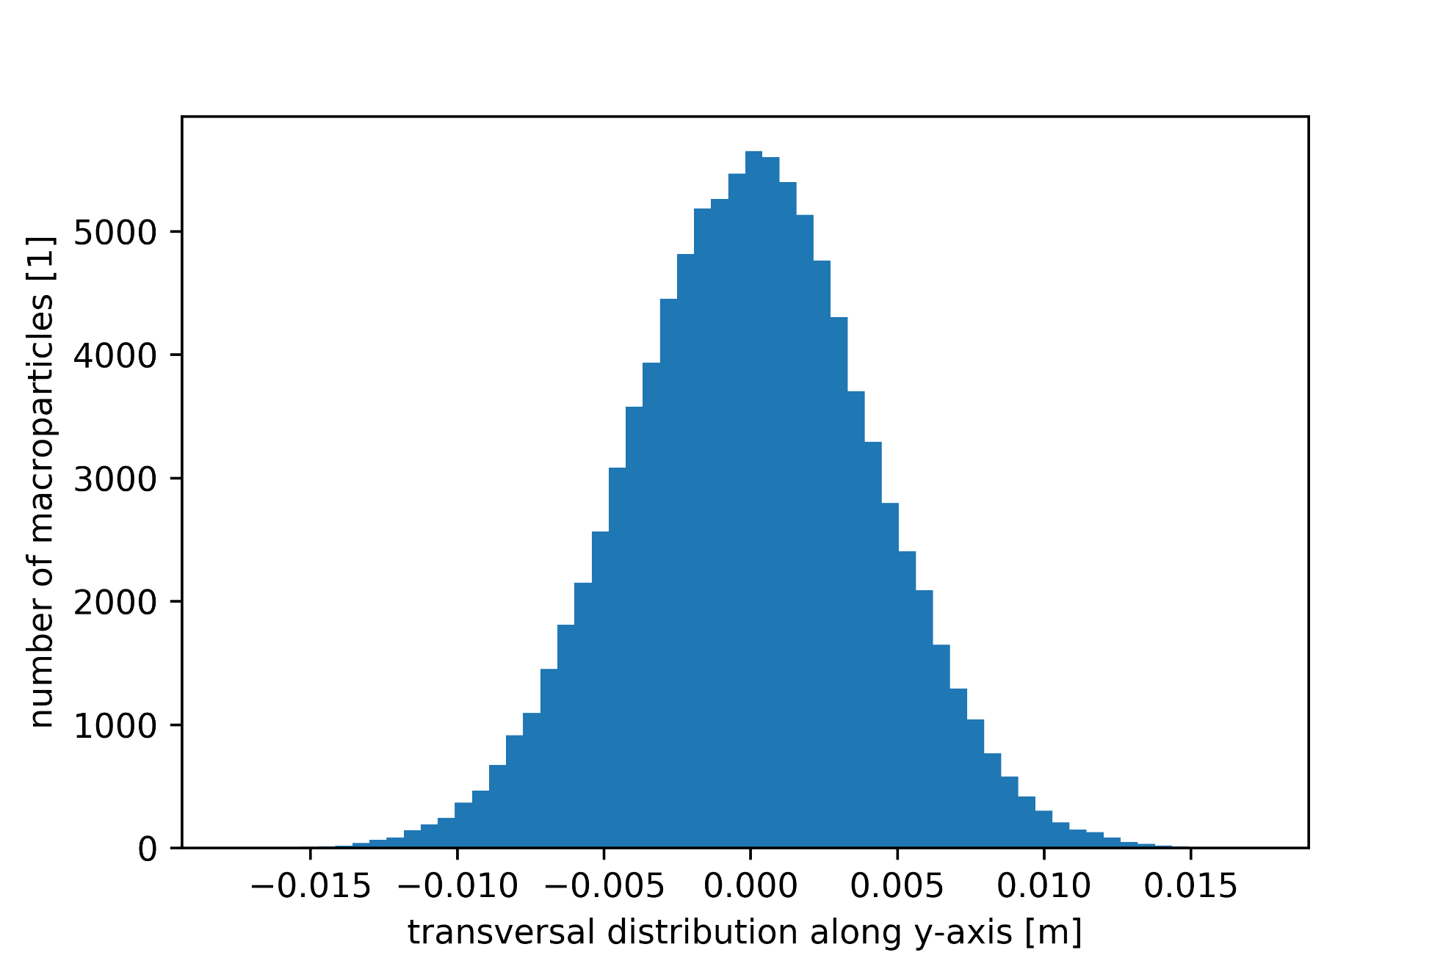
Gaussian distribution of the beam
Particles in the beam are Gaussian distributed in each direction

Slide 8
What is PyHEADTAIL?
Python software developed by HSC section and used to simulate
the synchrotrons
machine = LHC(
n_segments=1,
machine_configuration=machine_configuration,
**get_nonlinear_params(chroma=chroma, i_oct=i_oct))

Slide 9
What is PyHEADTAIL?
Python software developed by HSC section and used to simulate
the synchrotrons
the beam
intensity = 1.1e11
epsn_x = 3.e-6
epsn_y = 3.e-6
sigma_z = 1.2e-9 * machine.beta*c/4
bunch = machine.generate_6D_Gaussian_bunch_matched(
n_macroparticles, intensity, epsn_x, epsn_y, sigma_z=sigma_z)

Slide 10
What is PyHEADTAIL?
Python software developed by HSC section and used to simulate
the synchrotrons
the beam
the beam’s interaction with itself (e.g. via the vacuum pipes: wake fields)
wake_table = WakeTable(wakefile,
['time', 'dipole_x', 'dipole_y', 'quadrupole_x',
'quadrupole_y', 'dipole_xy', 'dipole_yx'])
wake_field = WakeField(slicer_for_wakefields, wake_table)
machine.one_turn_map.append(wake_field)

Slide 11
What is PyHEADTAIL?
Python software developed by HSC section and used to simulate
the synchrotrons
the beam
the beam’s interaction with itself (e.g. via the vacuum pipes: wake fields)
runs over many turns
n_turns = 10000
for i in range(n_turns):
machine.track(bunch)

Slide 12
Simulations of the PS

Slide 13
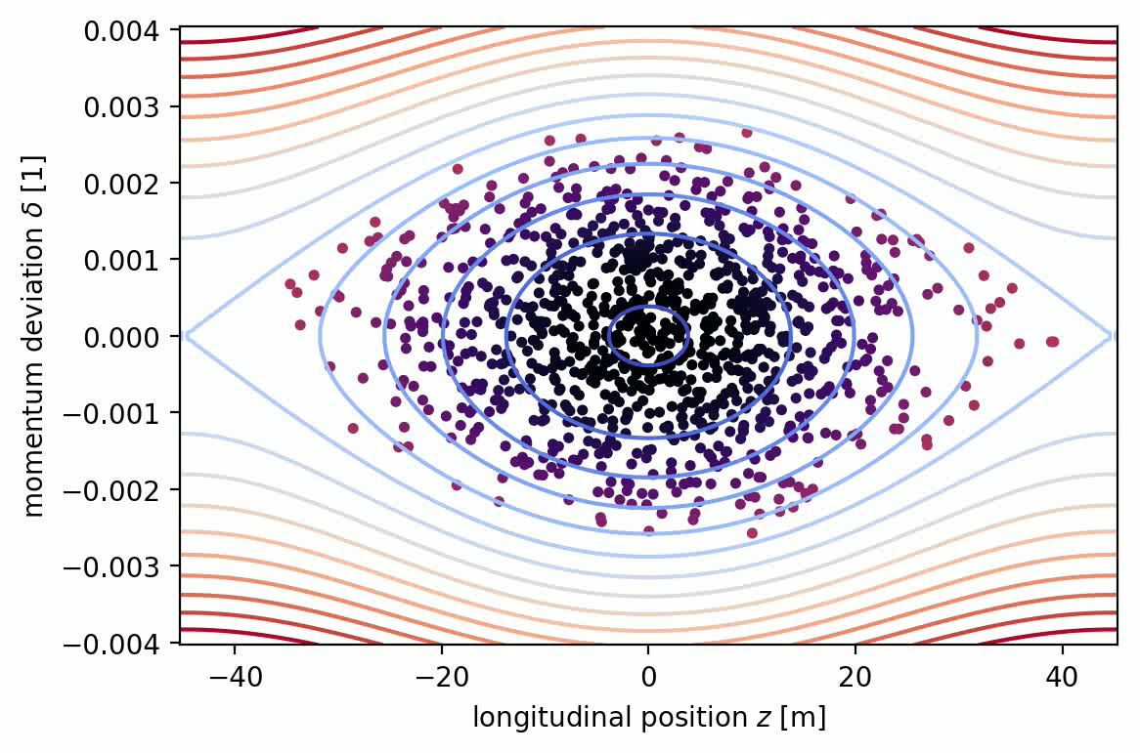
5’253 turns, 1 segment per turn, 1000 macroparticles

Slide 14
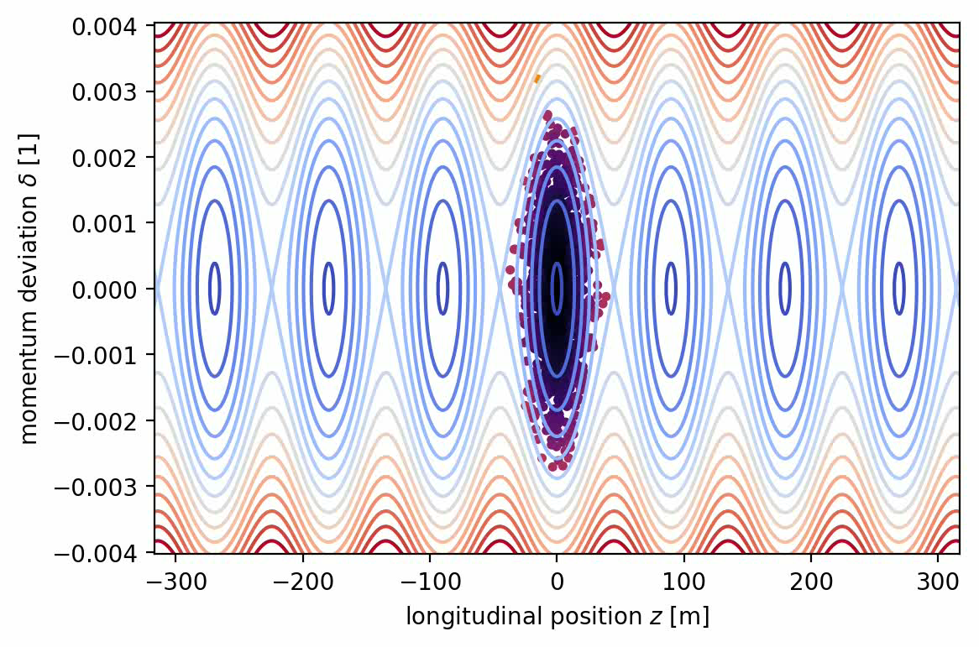
5’253 turns, 1 segment per turn, 1000 macroparticles

Slide 15
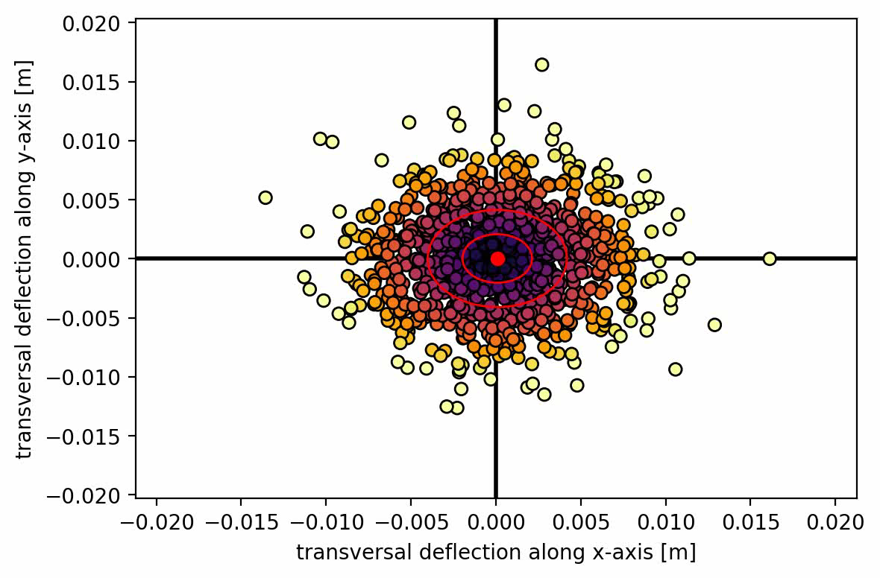
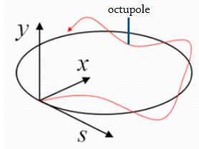
1 turn, 200 segments per turn, 1000 macroparticles
Q_x = number of oscillations in direction of x around closed orbit
Q_y = number of oscillations in direction of y around the closed orbit

Slide 16
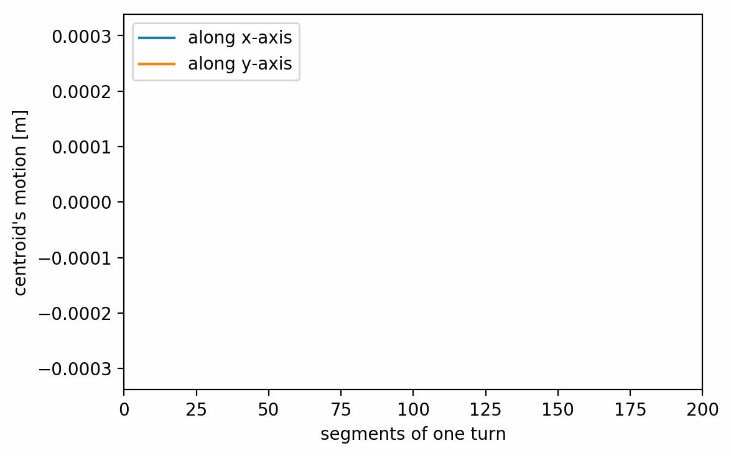
1 turn, 200 segments per turn, 1000 macroparticles

Slide 17
Simulations of instabilities in the LHC
Damper, chromaticity and octupoles

Slide 18
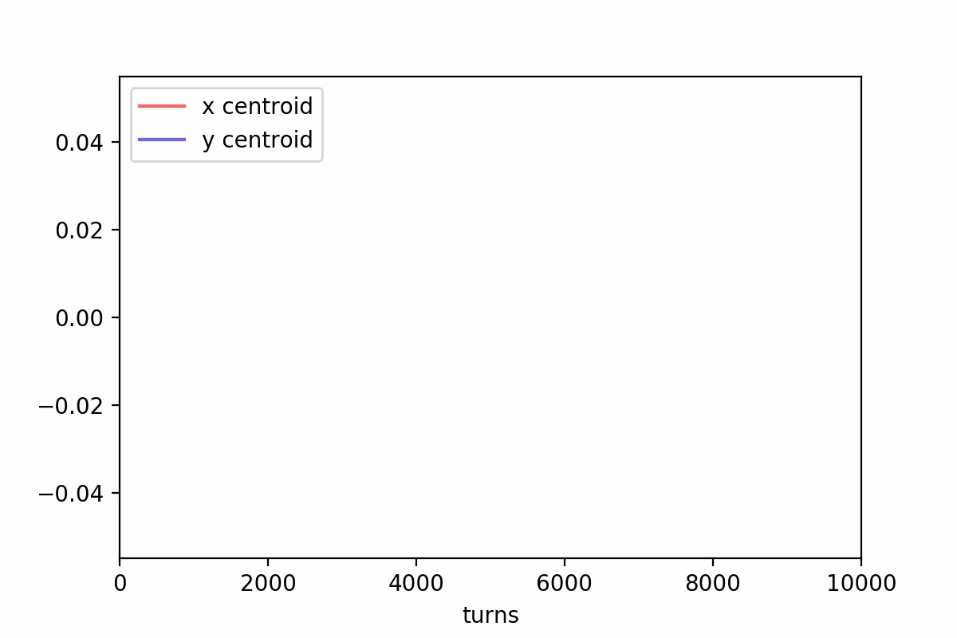
Without damper (10’000 turns, chroma=-15)

Slide 19
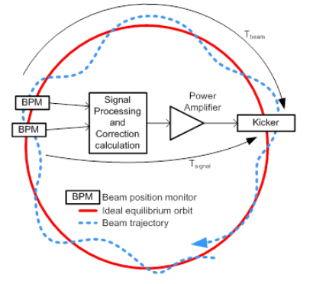
Damper
Feedback system
Kicker magnet in the ring which prevents the seen instabilities if their growth rate is slower than 50 turns

Slide 20
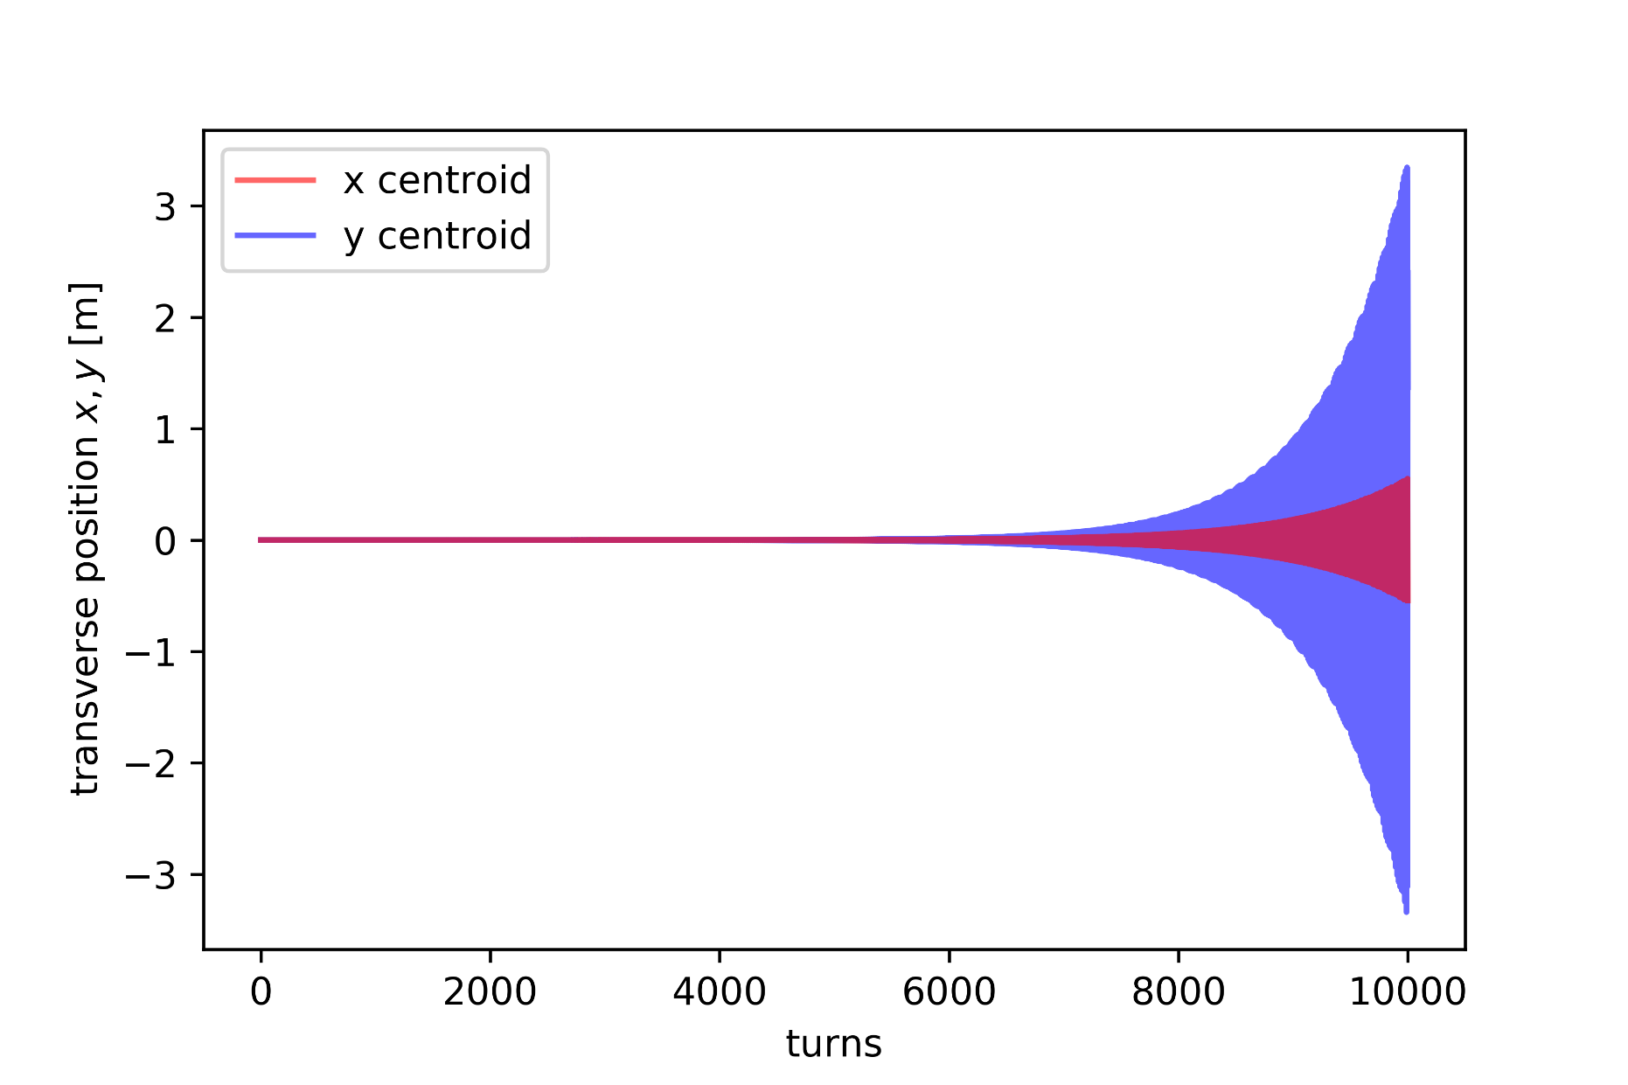
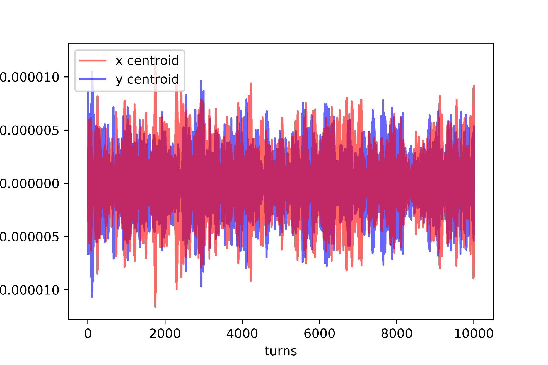
Damper’s impact (10’000 turns, chroma=-15)
Without damper
With damper

Slide 21
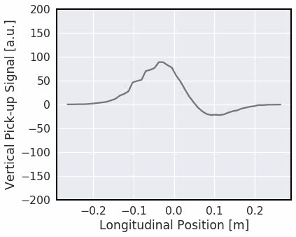
Effect of “chromaticity”
Negative (till now)
Only oscillations with mode = 0

Slide 22
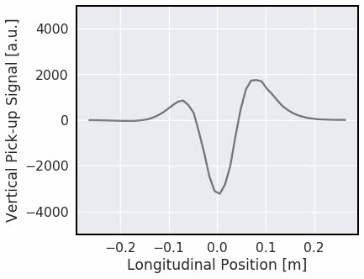
Effect of “chromaticity”
Negative (till now)
Positive (from now)
Only oscillations with mode = 0
Only higher-order modes
Default setting in CERN machines

Slide 23
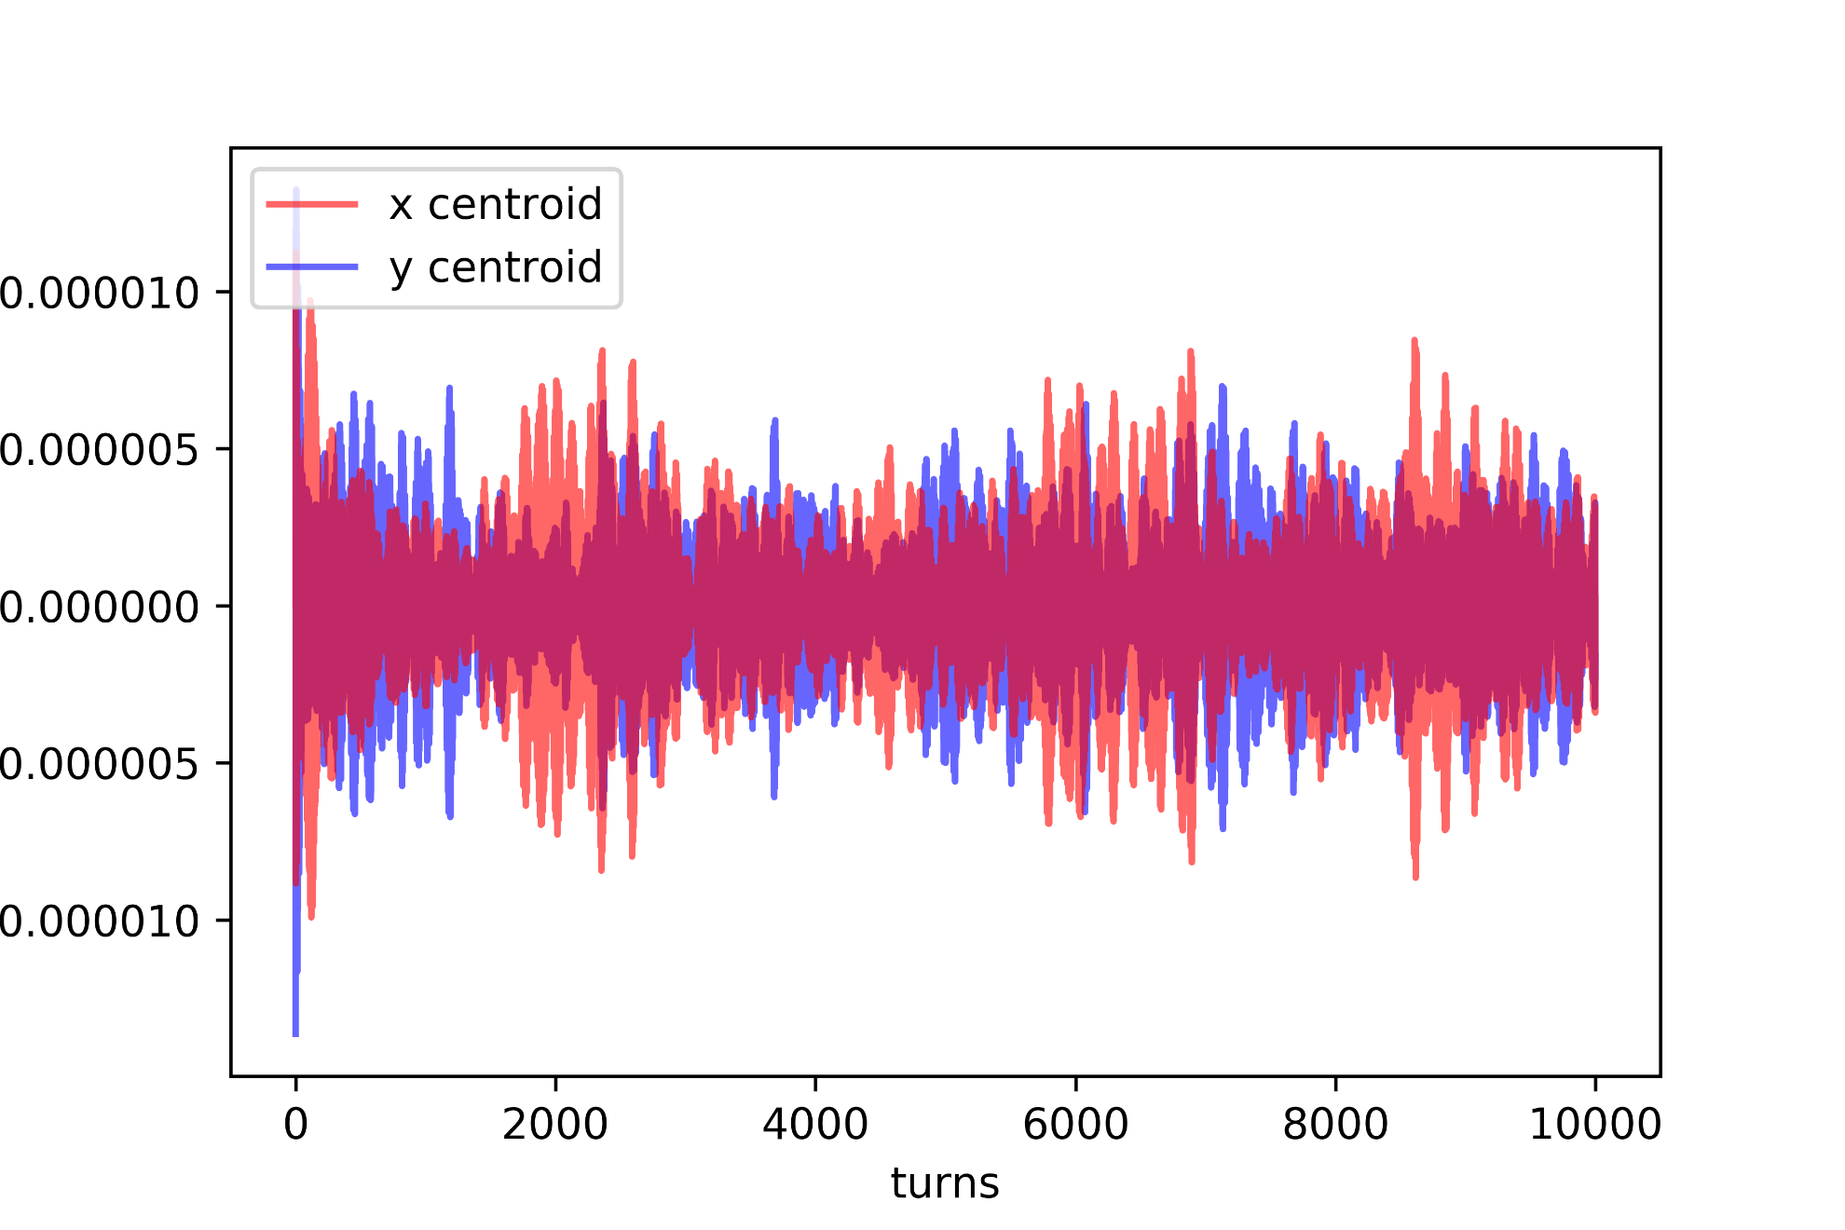
With damper (10’000 turns, chroma=10)

Slide 24
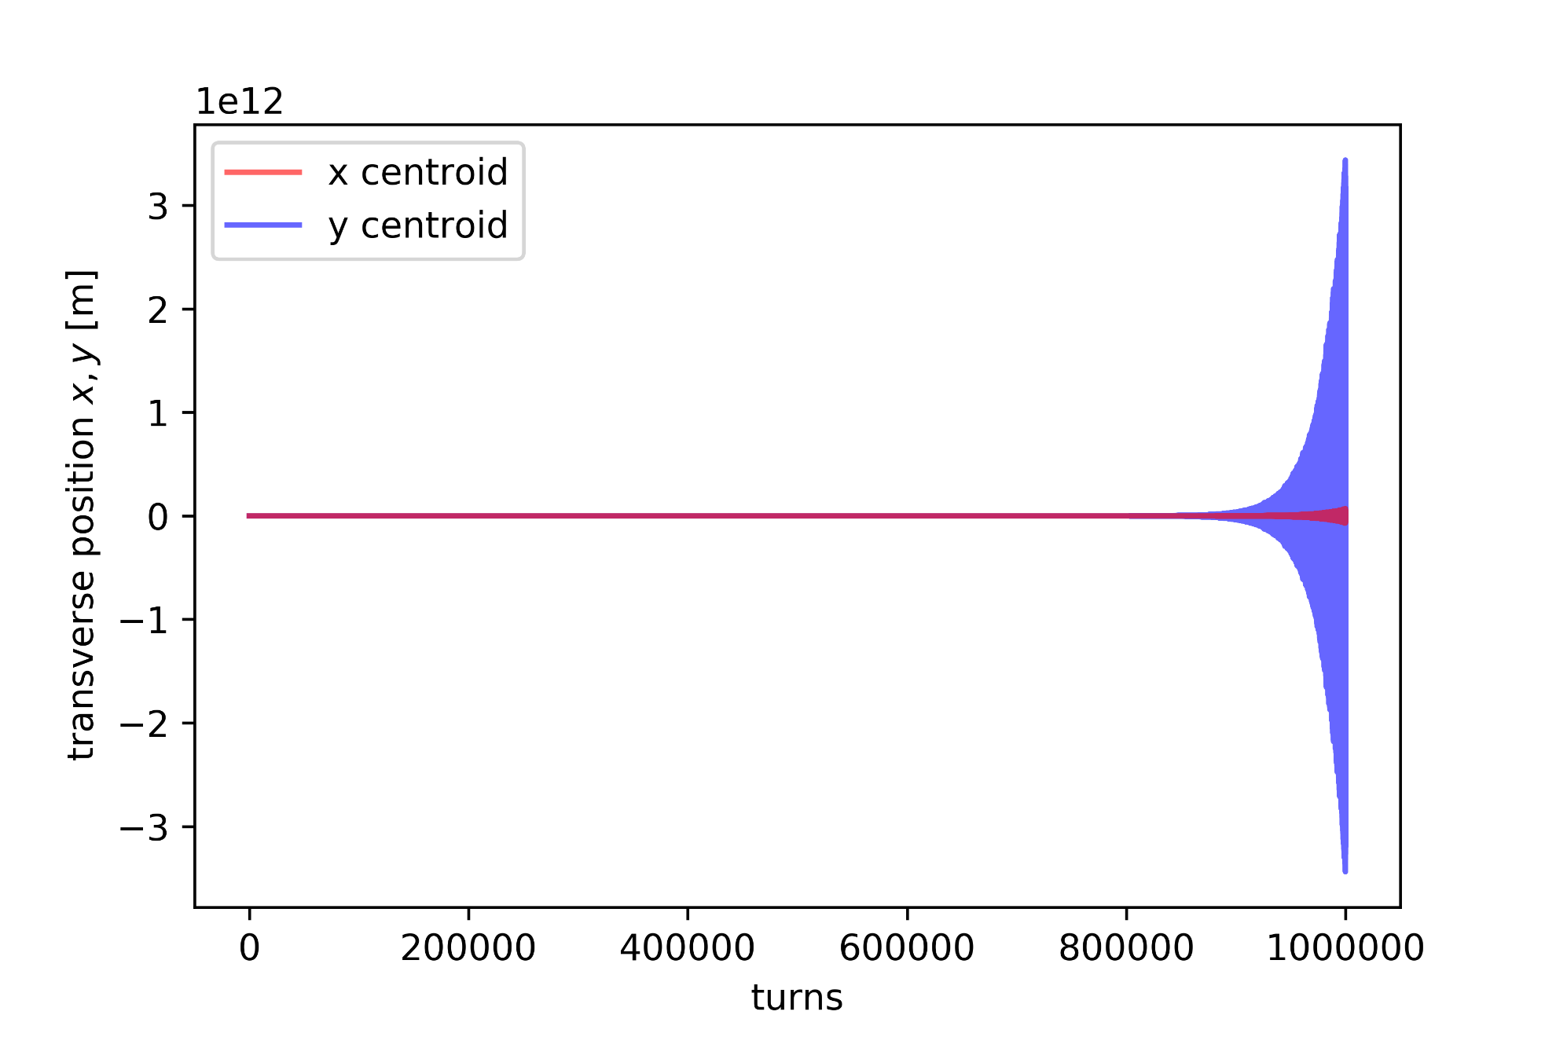
With damper(1’000’000 turns, chroma=10)

Slide 25
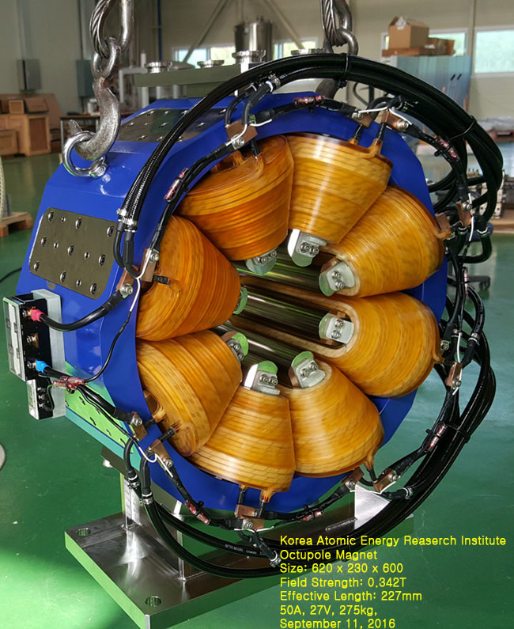
Octupole magnets
Can also fix instabilities of higher modes
Bad for single particle physics, good for multi particle physics

Slide 26
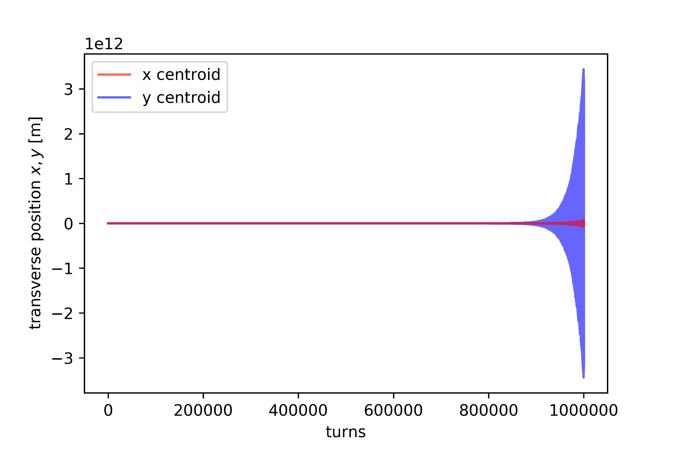
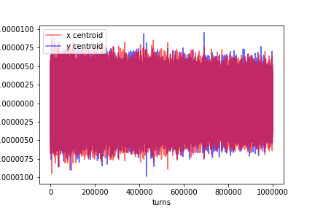
Octupoles’ impact (1’000’000 turns, chroma=10)
Without Octupoles
With Octupoles (I = 200A)

Slide 27

Real LHC Instability (02.04.2018) at chromaticity = 10, no octupoles
Time [~10min]
Tune Q_x

Slide 28
Summary
We learned and presented you:
About accelerator physics
Magnets: Dipoles (closed orbit), quadrupoles (focusing and oscillations), sextupoles (adjust chromaticity), octupoles (damping instabilities)
Wake fields and how they drive instabilities
Beam dynamics simulations
We also saw:
Meetings
Scientific presentations
Language mixture
Measurements of real beams in CCC

Slide 29
Sources
https://en.wikipedia.org/wiki/File:Magnetic_field_of_an_idealized_quadrupole_with_forces.svg
https://cds.cern.ch/record/40918
https://cy.wikipedia.org/wiki/CERN#/media/File:CERN_logo2.svg
https://cds.cern.ch/record/2298900/files/CERN-THESIS-2017-270.pdf
http://slideplayer.com/slide/5966462
http://slideplayer.com/slide/10891714/
http://lin12.triumf.ca/text/Talks/TrainingImages/Octupole.jpg

